Slide 1
Understanding the Mergers and Acquisitions Landscape in the AI Industry

Slide 2
Motivation and Problem Statement
AI development is rapid accelerating, and few tech giants dominate the market
Mergers, acquisitions, and investments allow firms to influence data, talent, resources, and infrastructure
Varying regulations under different administrations may influence corporate behavior and market concentration
The full impact of M&A activity and market concentration on competition, innovation, and smaller AI firms is not well understood

Slide 3
Research Goals and Contribution
Compare merger and acquisition activity of major AI and tech firms under the Trump and Biden administrations
Identify whether firms exhibit more aggressive acquisition behavior under different regulatory environments
Analyze how changes in M&A activity relate to market concentration the tech sectors
Contribute evidence to debates on antitrust policy and regulation in AI-driven markets

Slide 4
Existing Literature
“Beyond Price: A Technical Quality Framework for AI Antitrust”
Tech giants’ acquisitions contribute to market concentration in AI
Price-based antitrust frameworks struggle to capture competitive harm in AI markets
“Digital (Killer?) Acquisitions”
Most tech acquisitions target firms without patents
Acquisitions generally do not reduce innovation
Highlights importance of analyzing patterns of acquisitions
“Artificial Intelligence and the Changing Political Landscape: The Impact of Trump’s Return on AI Governance and Policy”
Biden - Stronger regulation and compliance focus
Trump – Looser oversight, fewer restrictions
When look at these works, they demonstrate the need for a closer examination of how behavior and market across AI firms may vary by regulatory environment.
Notes:
Existing AI antitrust research highlights limitations of price-based frameworks in capturing competitive harm in digital and AI markets
Studies on tech and “killer” acquisitions show mixed effects on innovation, emphasizing the importance of analyzing acquisition patterns rather than individual outcomes
Political and regulatory environments vary across administrations, shaping antitrust posture and enforcement priorities
Together, these gaps motivate a closer examination of how AI and tech firms’ merger and acquisition behavior varies across regulatory contexts

Slide 5
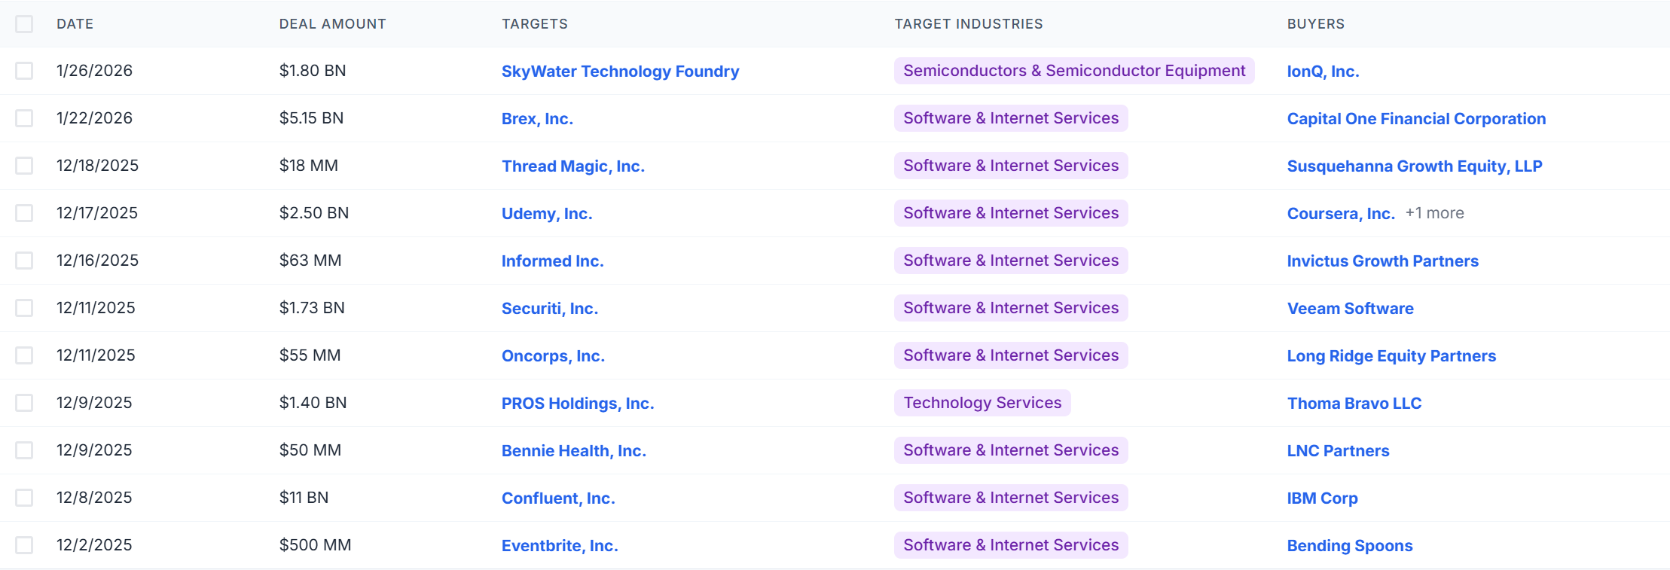
Data & Methodology
Data
M&A data
CrunchBase, PitchBook, PrivCo, etc.
Time Period
Biden and Trump administrations
Industry
AI industry
Data Characteristics
Deal date, acquirer, target, deal type (merger, acquisition, minority stake), deal size
*Example of Potential Data
Notes:
Mention the GAFAM tech Giants, I assume these will be the main companies we are collecting data for
Google (Alphabet), Apple, Facebook (Meta), Amazon, and Microsoft

Slide 6
Data & Methodology
Methodology
Data Collection
Collect M&A data for major AI firms
Classify deals by year, firm, deal type, etc.
Acquisition Analysis
Measure the acquisition intensity (deals per firm per year)
Analyze deal type
Market Concentration
Examine whether periods of increased M&A activity align with rising concentration in the sector
Comparative Analysis
Compare acquisition analysis and market concentration measurements across presidential administrations
Analyze whether different regulatory behavior is associated with firm behavior
Interpretation
Interpret results as associations
Use findings to inform debates on antitrust enforcement and AI market power
Notes:
Measure acquisition intensity as deals per firm per year across administrations
Analyze deal characteristics, including target size, sector overlap, and AI relevance
Track changes in market concentration using firm share proxies over time
Examine whether periods of increased M&A activity coincide with rising concentration in the AI and tech sector
Potential way to measure market concentration (HHI)

Slide 7
Timeline
Literature Review & Project Setup – 1 or 2 weeks
Data Acquisition & Cleaning – 2 weeks
Preliminary Analysis – 1 week
Comparative Analysis - 2 weeks
Final/Advanced Analysis & Data Visualizations – 2 weeks
Draft Report and Presentation Finished – 2 weeks
Final Revisions – 1 week

Slide 8
Thank you! Questions?

